Slide 1


Biostatistics I
Michael Dang

Slide 2

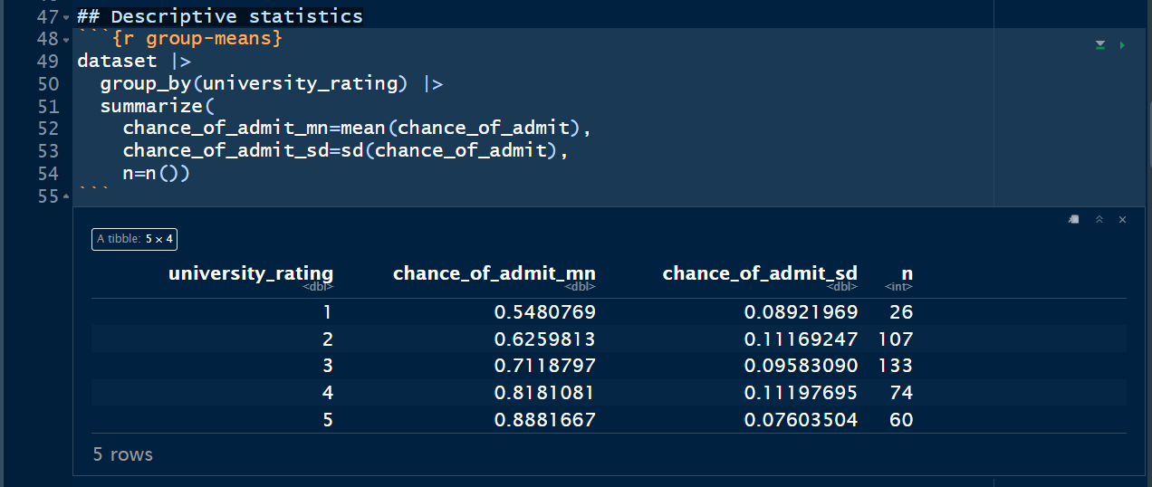
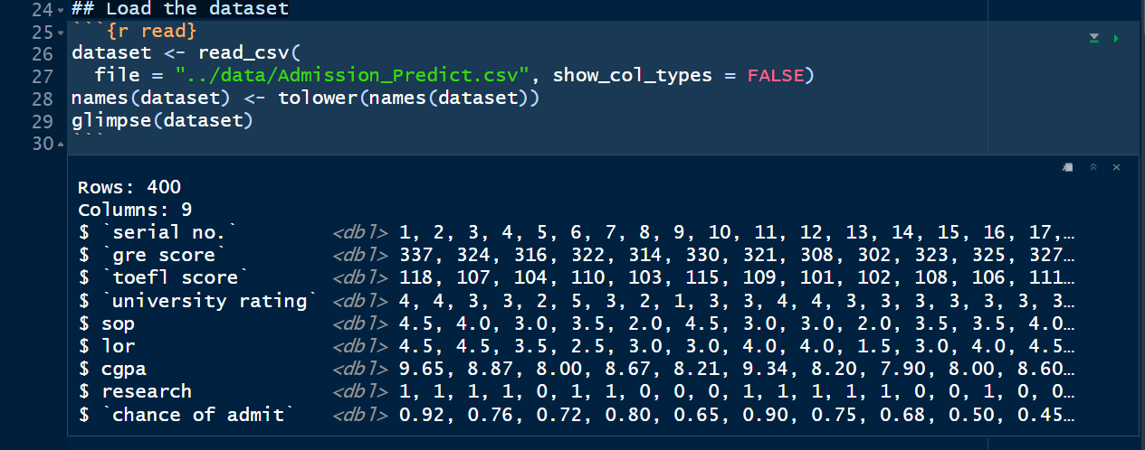
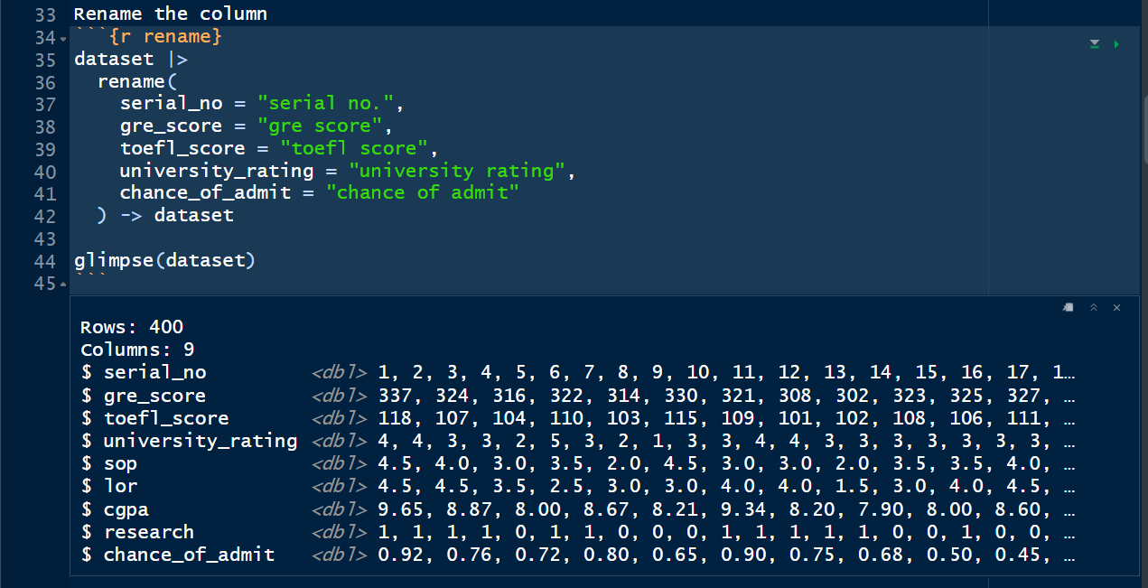
Dataset
Graduate Admissions Dataset:
Focused on graduate admissions from an Indian perspective.
Inspired by the UCLA Graduate Dataset.
Key Features:
Academic performance, test scores, university ratings, and research experience.
Ideal for predicting admission likelihood.
As the University Rating increases the Chance of Admit decreases. More than half of the applications were applied to 2nd and 3rd University Rating.

Slide 3
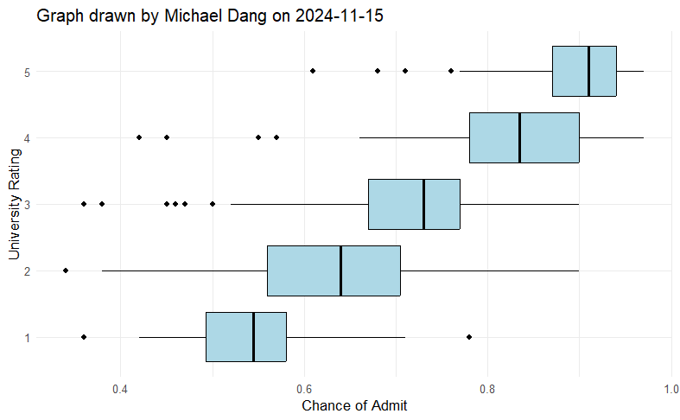
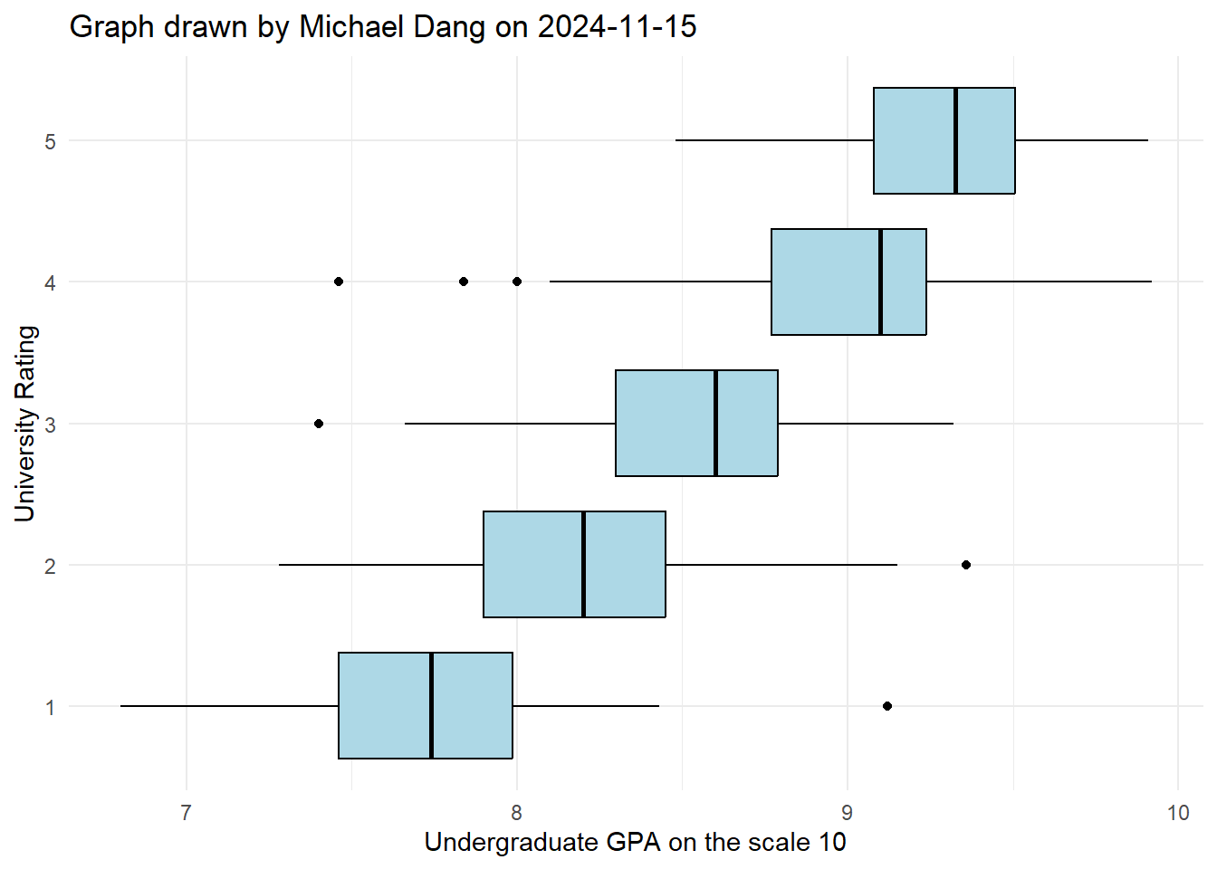
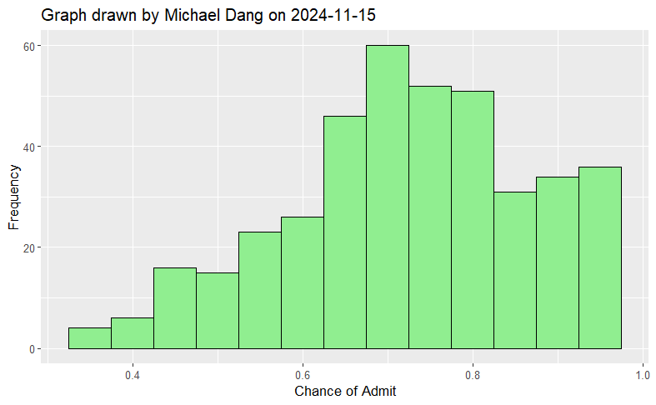
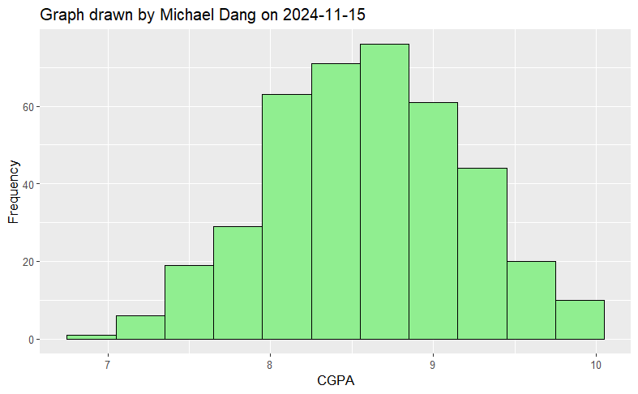
Plot

Slide 4
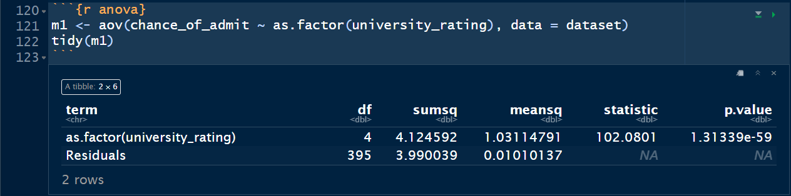
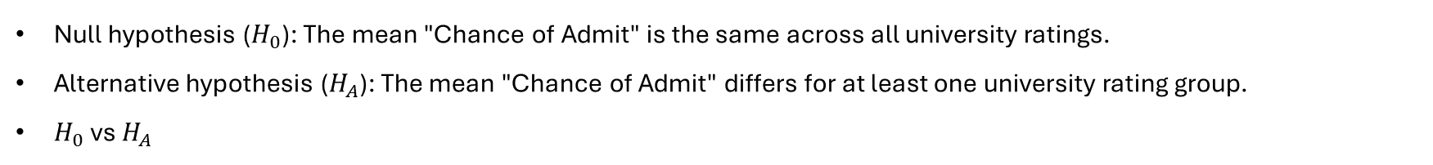
Analysis
Null hypothesis ($H_{0}$): The mean "Chance of Admit" is the same across all university ratings.
Alternative hypothesis ($H_{A}$): The mean "Chance of Admit" differs for at least one university rating group.
$H_{0}$ vs $H_{A}$
The F-ratio is large, and the p-value is small. We conclude there is a difference for at least one university rating group.
Since ANOVA indicates significant differences, perform post-hoc tests (i.e., Tukey's HSD) to identify which specific groups (university ratings) differ from each other.

Slide 5
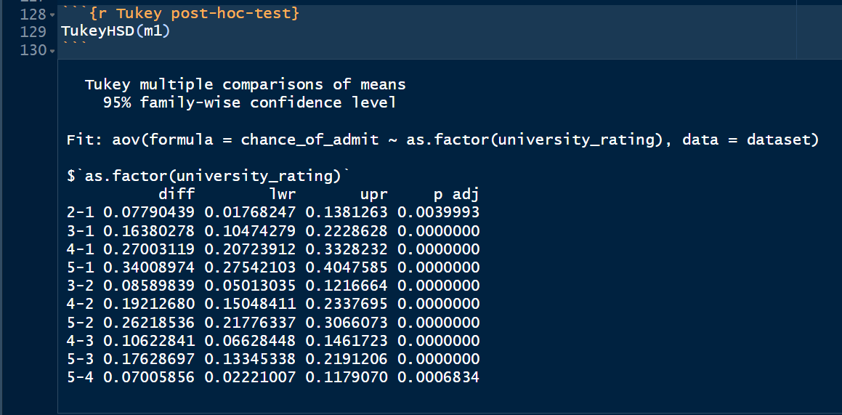
Analysis
Statistical Significance: All pairwise comparisons have p-values less than 0.05, indicating that the differences in means are statistically significant.

Slide 6
Thank you

